Slide 1
US Air Traffic Forecast
Evan Adinolfe

Slide 2

Goal of the Forecasts
Goal
Forecast the total amount of flights in the US for the next year.
Why
Want to highlight monthly trends in the data to help airlines and airports make the best decisions regarding supply and demand and staffing.

Slide 3

Goal of the Forecasts
Data
Monthly data capturing the total amount of flights in the US from 2003 to 2023.
Reliability
This reliable data set is from the US Department of Transportation Bureau of Transportation Statistics.

Slide 4
Methodology
Forecasting Models:
Residual Analysis:
Main Accuracy Measure:
Naive
Residual plot
MAPE:
Mean Absolute Percent Error
Simple Smoothing
ACF plot
Holt-Winters
Histogram
ARIMA

Slide 5
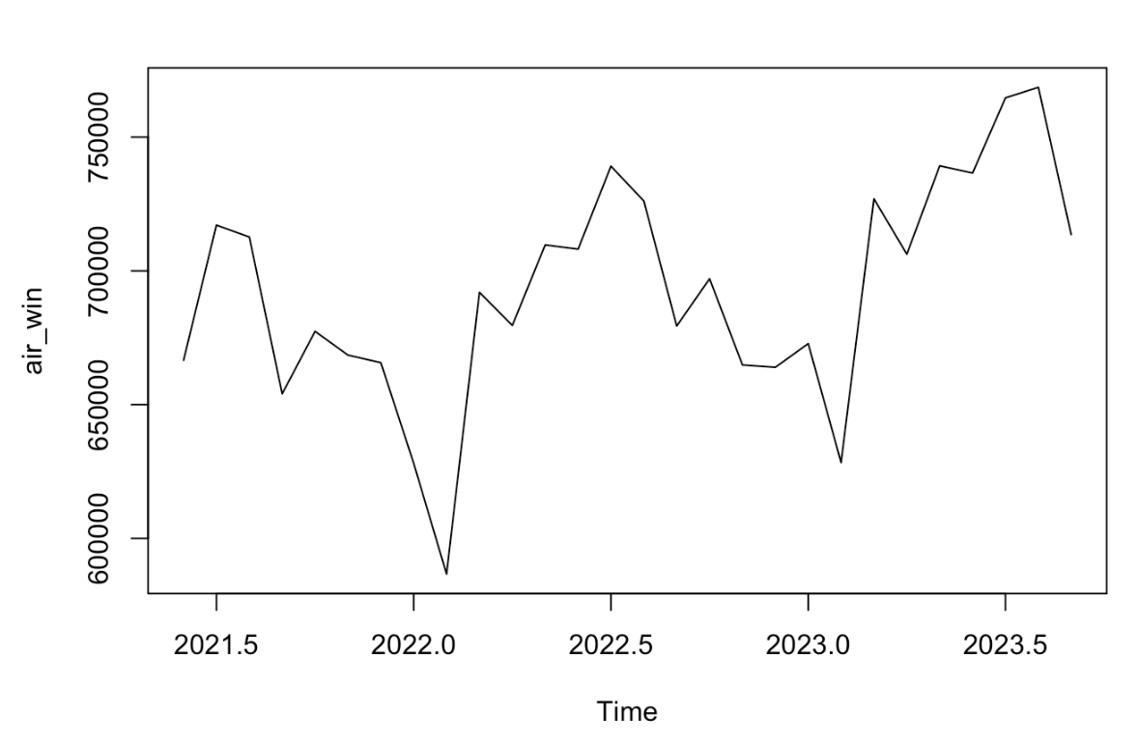
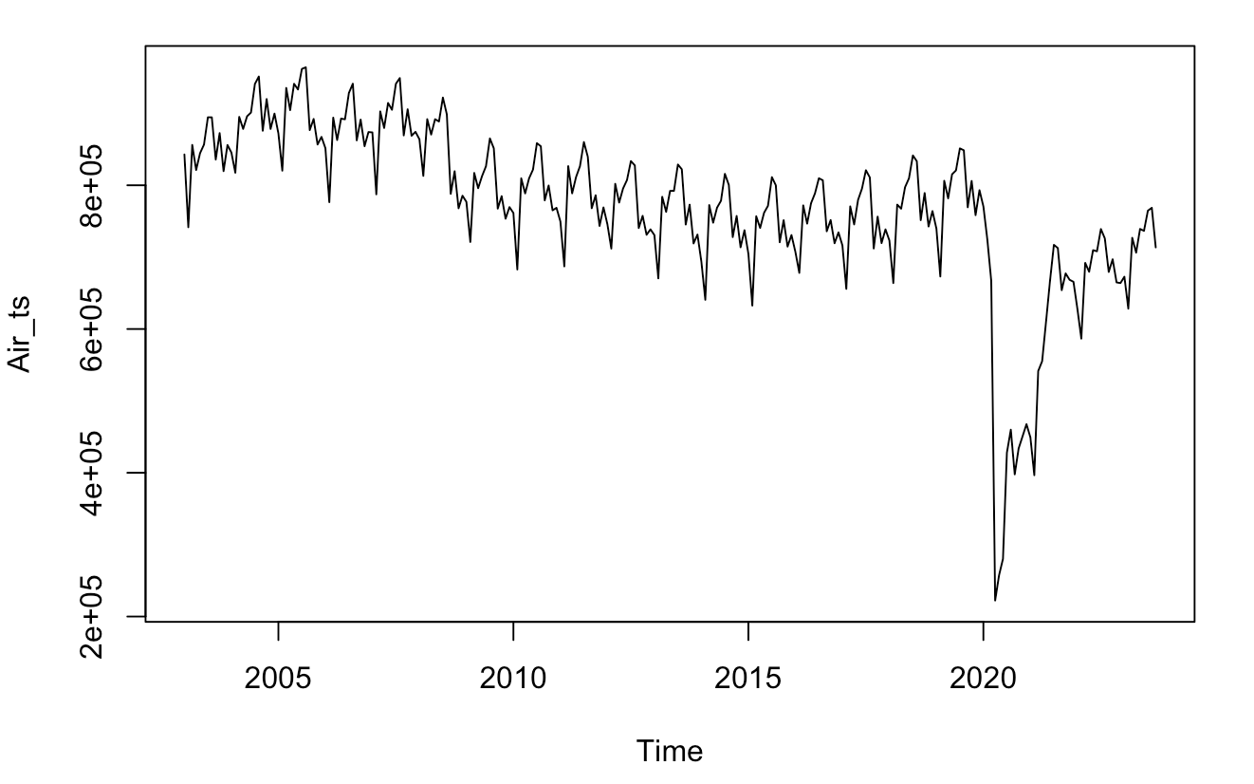
Time Series Data and Window
Original Time Series
Added Window
Data is taken from 2003 to 2023
Large drop in 2020 due to COVID
Shortened time series data with a window starting from June 2021. Air traffic returns to normalcy from COVID at this point

Slide 6
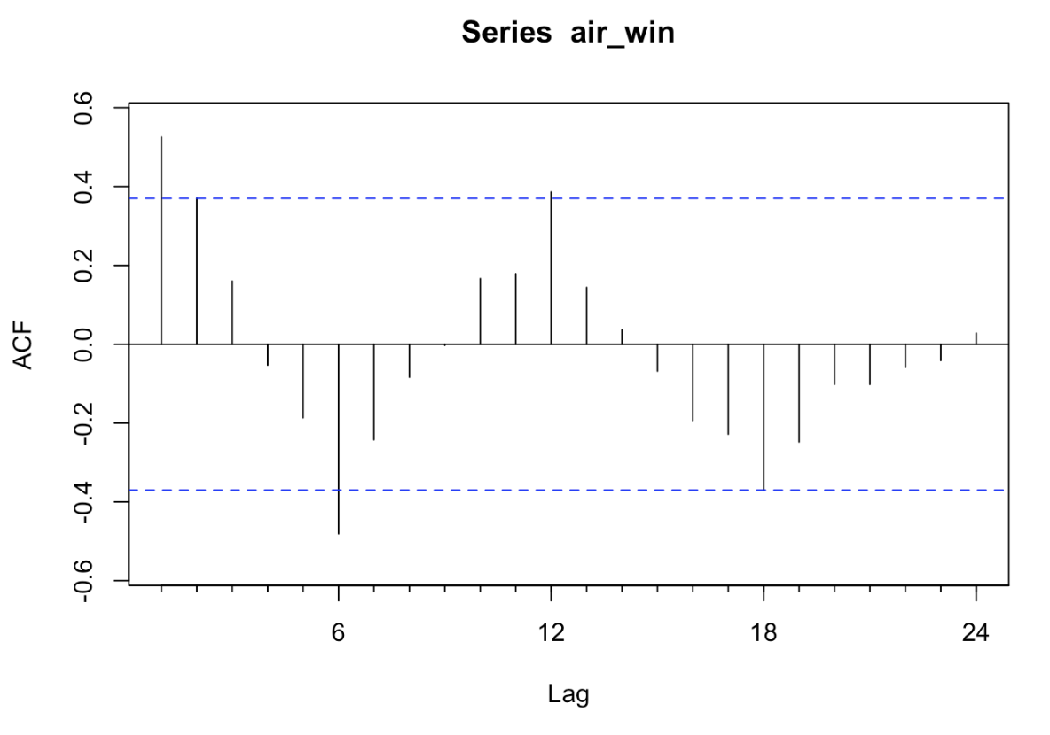
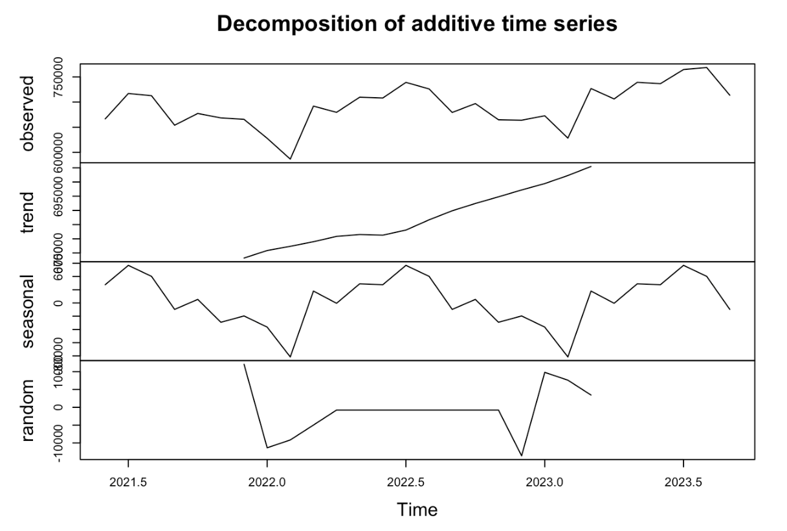
Trend and Seasonality Insight
Seasonal Values
January -36,456
February -81,554
March 17,998
April -471
May 28,963
June 27,610
July 56,817
August 40,217
September -9708
October 5,384
November -29,183
December -19,618
ACF
Decomposition
Shows a seasonal trend as there are spikes at every 6 lag values
- Seasonal trend is evident.
- Number of flights is lowest in the winter months, and highest in the summer months.
- Indicates that people travel more in the summer because weather is nice for vacations. Winter is colder and there are more holidays, leading people to stay home.

Slide 7
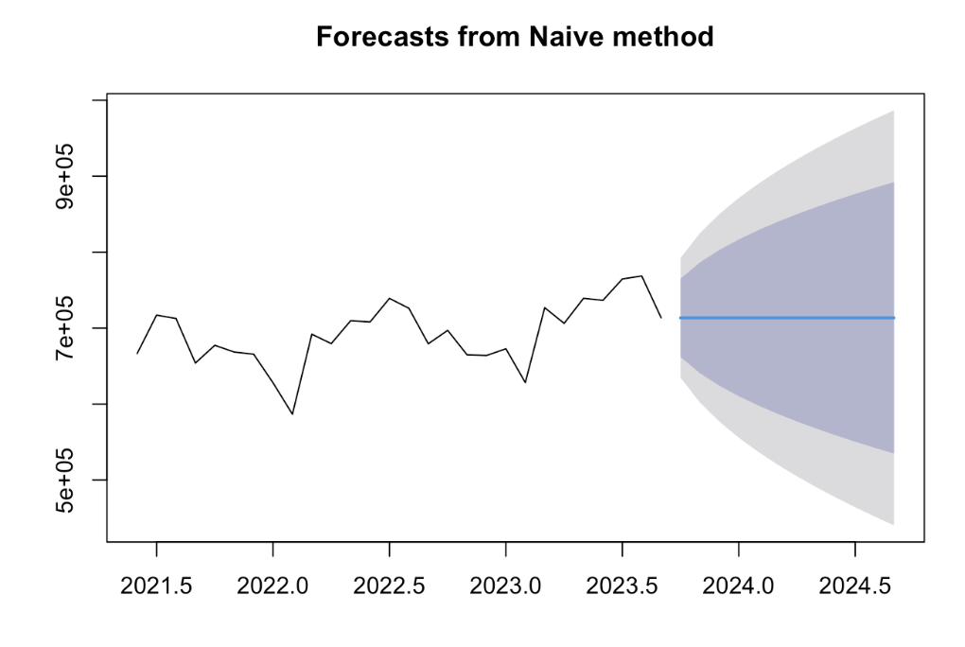
Naïve Method

Slide 8
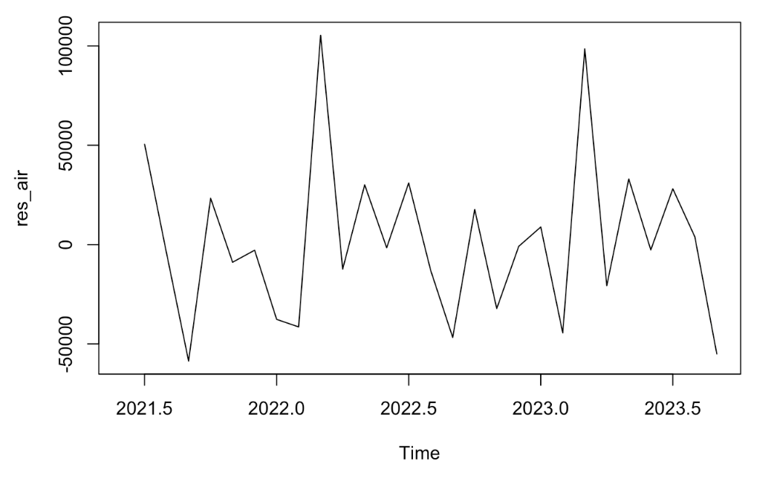
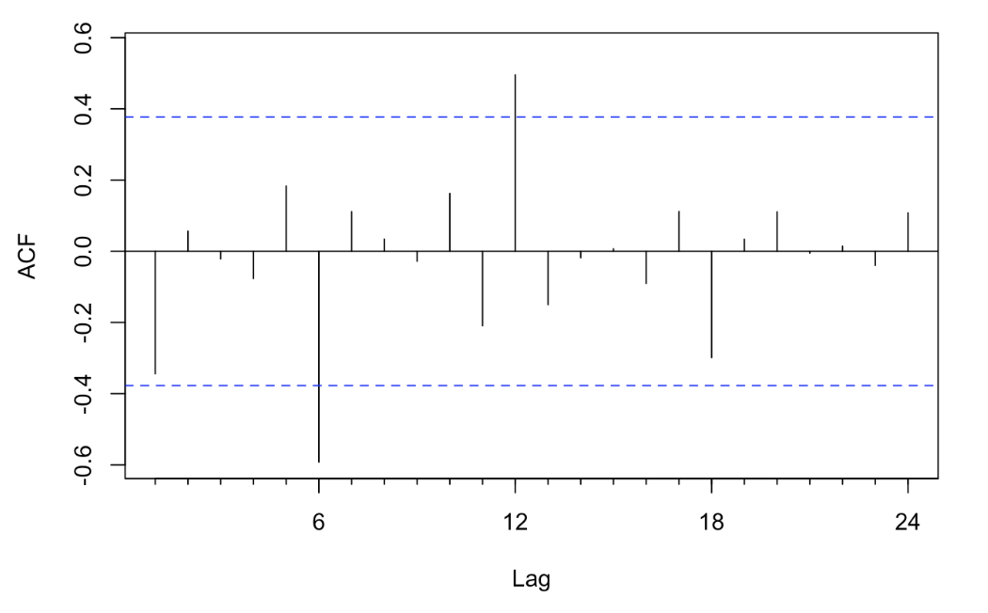
Naïve Method: Residual Analysis
Many large errors scattered throughout time series
No trend in the residuals

Slide 9
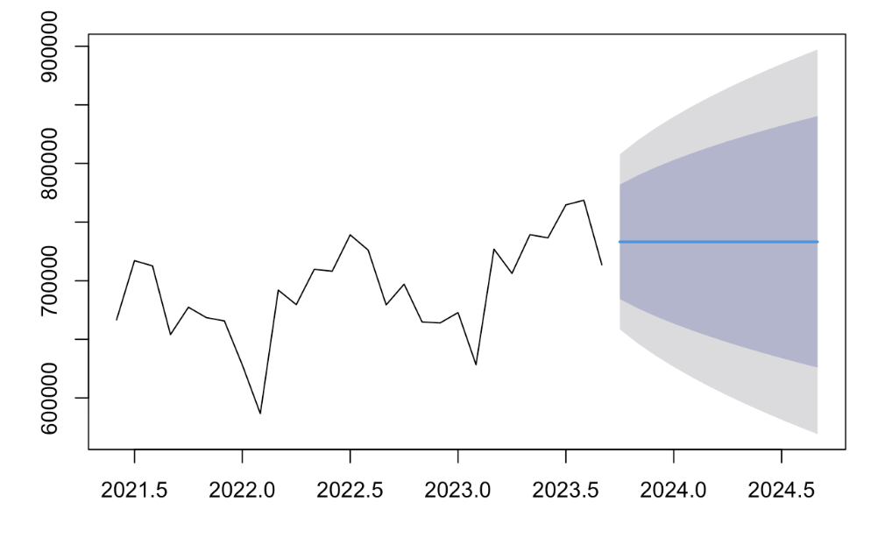
Simple Smoothing

Slide 10
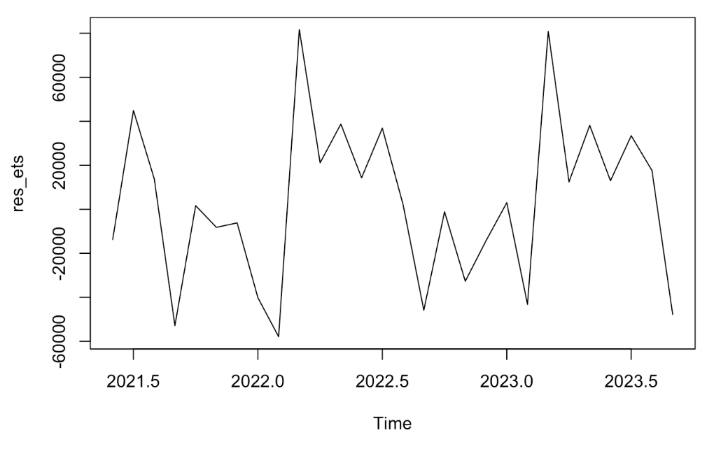
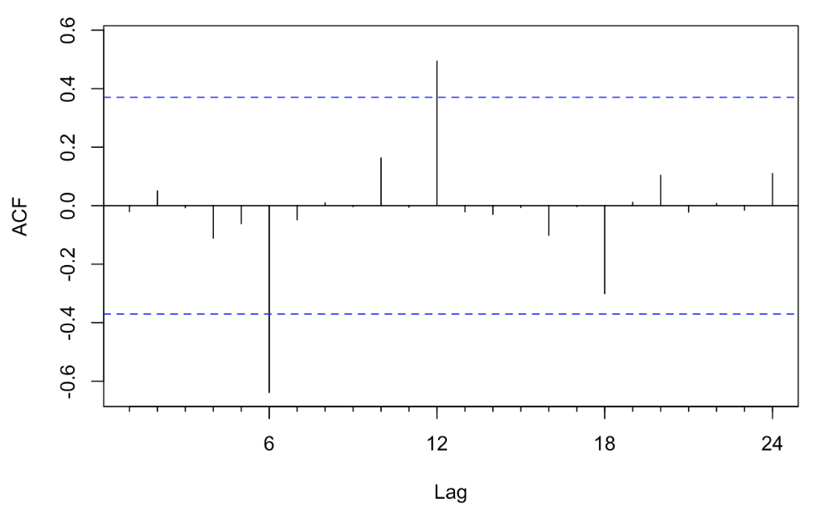
Simple Smoothing: Residual Analysis
Large errors are present throughout, but they are smaller compared to the Naïve Method
No trend between residuals and time series

Slide 11
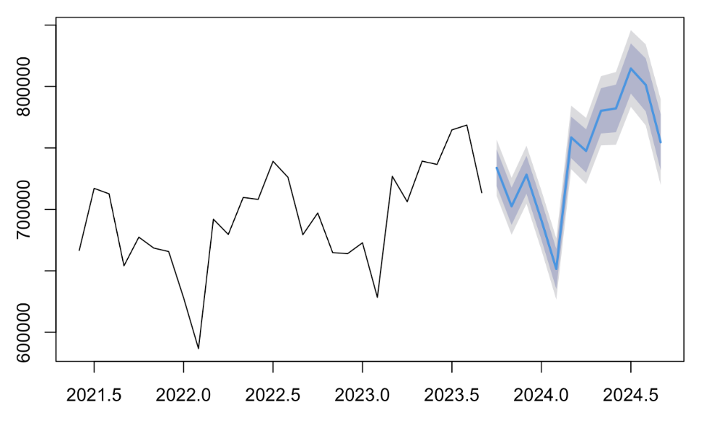
Holt-Winters

Slide 12
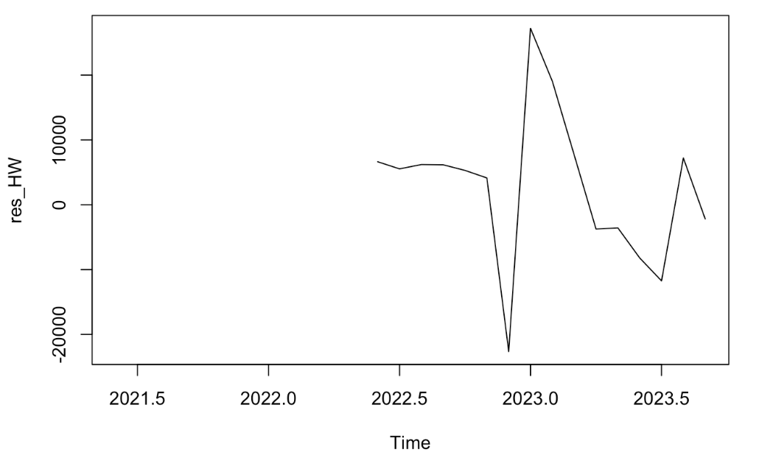
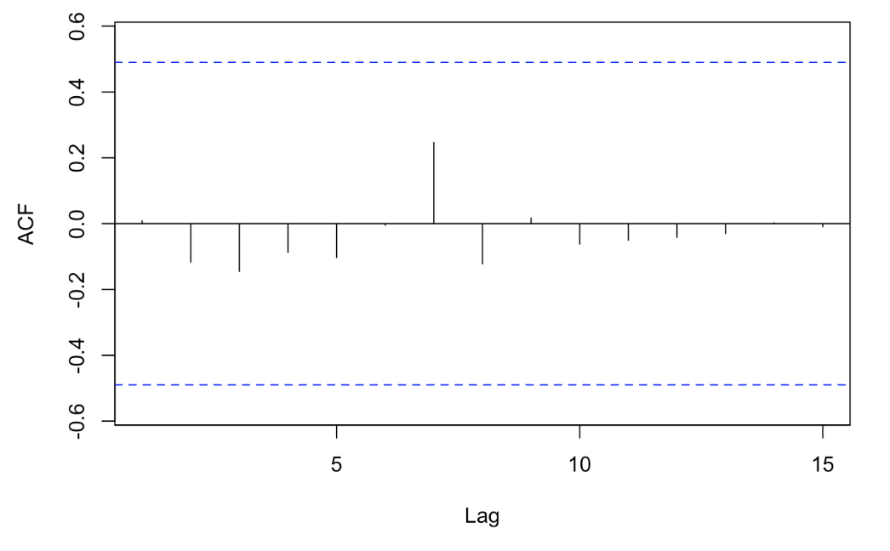
Holt-Winters: Residual Analysis
Some larger errors, but most errors are smaller
No trend seen in the errors

Slide 13
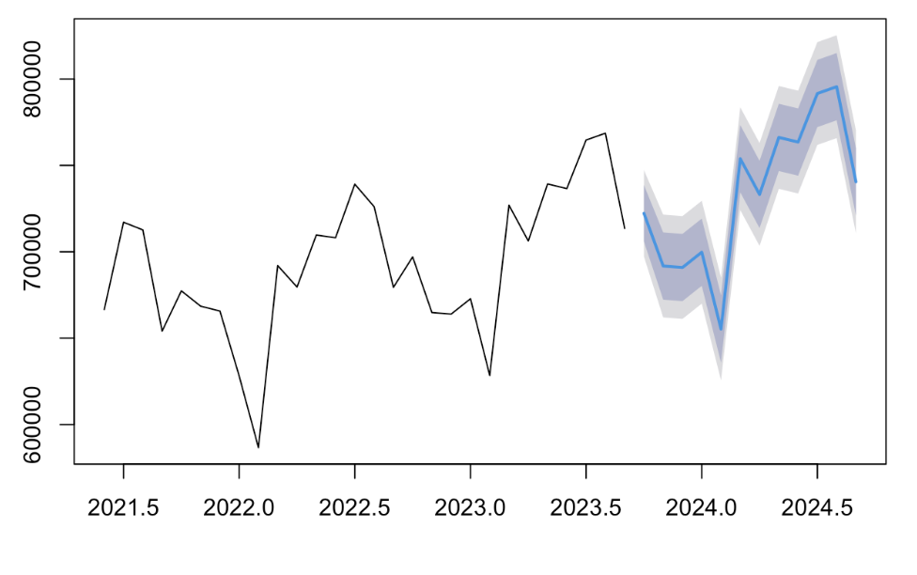
ARIMA

Slide 14
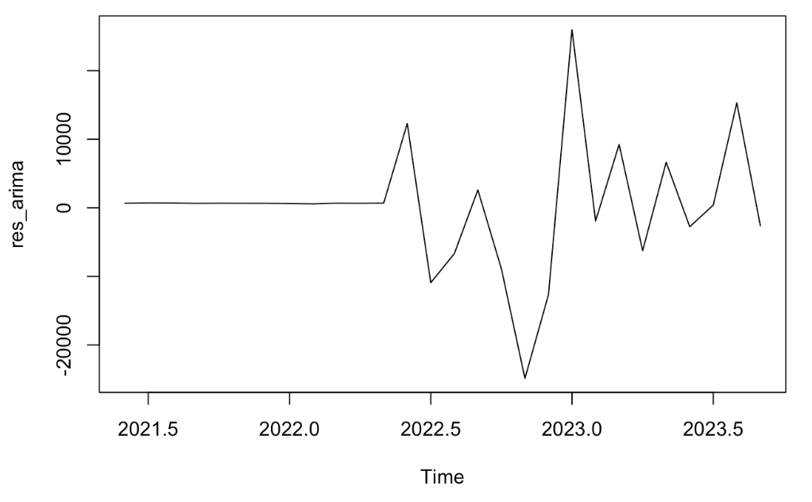
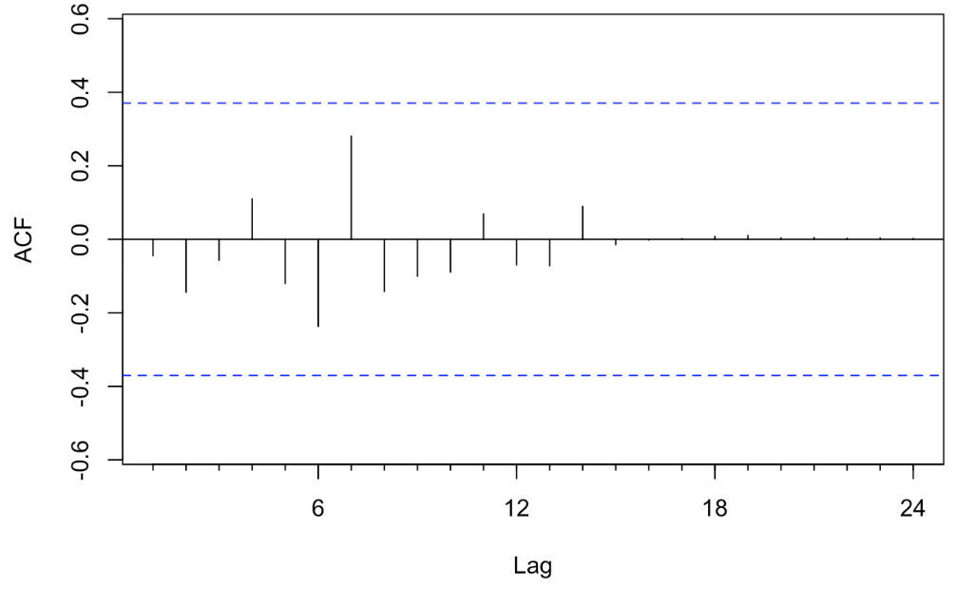
ARIMA: Residual Analysis
Large error near 2023, but most errors are small for this dataset
No trend between errors and the time series

Slide 15
Judgment and Comparison Summary
Method | Forecast | ACF shows trend? | Error Size and Quantity | MAPE
Naive | Forecasts the same value of 713,549 total flights for every month. | No | Many errors throughout time series and reach up to a value of 100,000 | 4.3845
Simple Smoothing | Forecasts the same value of 733,171 for every month, similar to Naïve method. | No | Errors scattered throughout time series and have values of 60,000 | 4.2565

Slide 16
Judgment and Comparison Summary
Method | Forecast | ACF shows trend? | Error Size and Quantity | MAPE
Holt-Winters | Displays seasonality, forecasting 814,619 flights in July, a busy month, and 651,537 in February. | No | Histogram shows errors are concentrated around zero | 1.3298
ARIMA | Shows seasonality similar to Holt-Winters, but the forecast is more accurate. July projects to have 791,616 flights, and February projects to have 655,284. | No | Histogram shows errors are concentrated around zero, showing they are all small | 0.8080

Slide 17
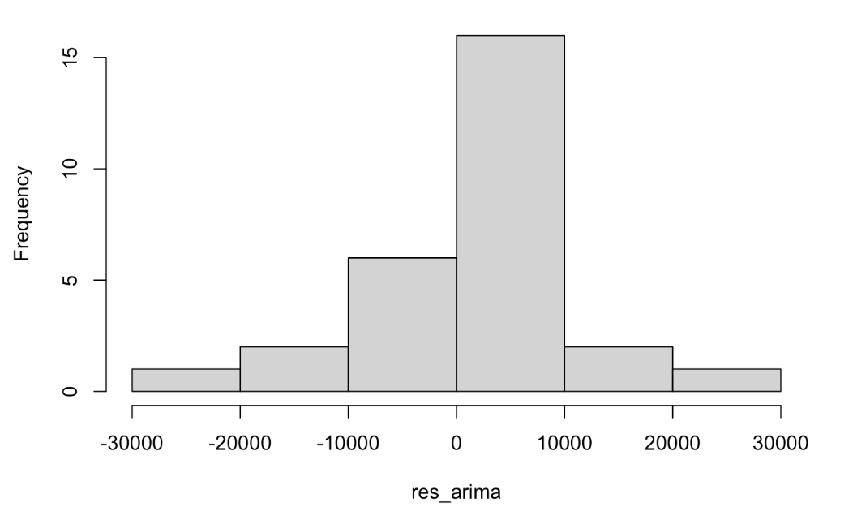
Recommended Forecast
ARIMA
Displays most accurate seasonality flight trends from past years
No trend in residuals
Errors are small, as most fall between 0 and 10,000 values
MAPE is the lowest of all models at 0.8080

Slide 18
Conclusion
Insights
Airline companies should have more planes and pilots on staff for the summer months, as there will be an increased amount of flights being booked during this time. Airports can also prepare for this by having more air traffic control workers during the summer, as well as more restaurants open for the larger crowds. In the winter, there are less flights throughout the US, so airline companies can limit the amount of planes being flown to limit mileage and fuel costs.
2023
2024
Monthly Forecast
(from Sep 2023)
Oct | Nov | Dec | Jan | Feb | Mar | Apr | May | Jun | Jul | Aug | Sep
722k | 691k | 690k | 699k | 655k | 753k | 733k | 766k | 763k | 791k | 795k | 740k

